Slide 1
Towards Personalised Medicine: Leveraging Soft Voting Classifier for Mortality Prediction of ICU Patients with Heart Failure
Dissertation by Om Shirke
MS Data Science
Liverpool John Moores University

Slide 2

MOTIVATION AND BACKGROUND
Heart failure is a life-threatening condition and a leading cause of death globally. Patients with heart failure often have a narrow window for intervention before the condition becomes fatal, requiring rapid medical response and timely interventions to avoid fatal outcomes. The kind of critical care necessary for these patients is typically found only in hospital ICUs. Thus, early identification of high-risk patients in ICUs could allow for tailored, timely interventions, potentially reducing mortality and enabling more efficient management of ICU resources to optimise patient care.

Slide 3
RESEARCH GOALS
Develop an accurate Mortality Prediction Model that can effectively predict mortality cases early on in an ICU using patient physiological data.
Refine data preparation and feature selection processes while effectively addressing mortality data imbalance.
Optimise the final mortality classifier to minimize the misclassification of true mortality cases, as much as possible, thereby contributing to enhancing clinical decision-making.

Slide 4








LITERATURE REVIEW
ML in Healthcare
ICU Scoring Systems
Computational Approaches
Mortality Prediction
Estimation of length of ICU stay
Early detection of tumor, diabetes, sepsis, etc.
Standardised benchmarking of ML in heathcare
APACHE II and III.
SOFA
qSOFA
NEWS
SAPS
Kinds of datasets used.
Types of data processing techniques employed.
Feature Selection and Class Balancing techniques
Performance evaluation metrics analysed.
Hidden Markov Model
Ensemble and Hybrid Model with various mainstream models.
Hybrid Model with DNN and XGBoost.
Models with Explainable AI

Slide 5
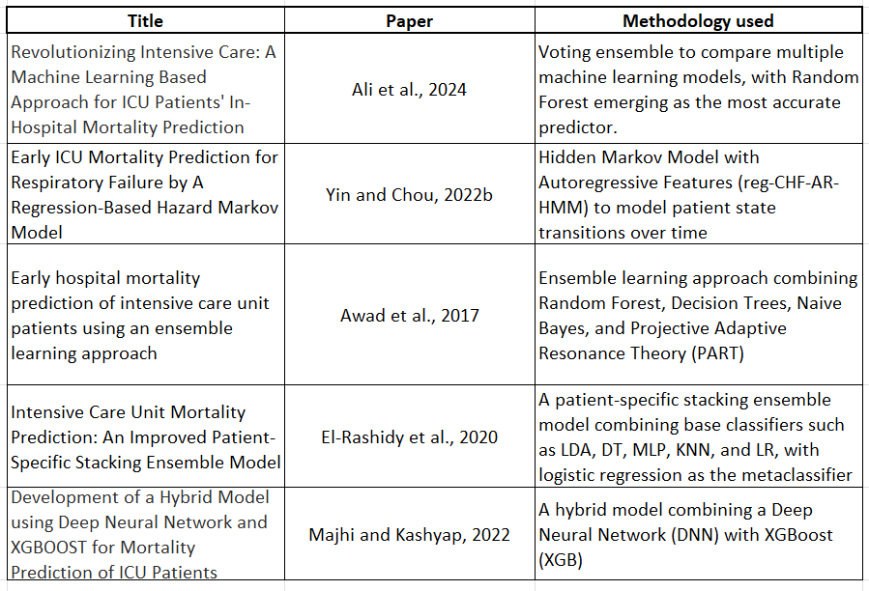
LITERATURE REVIEW
Multiple clinical and mortality prediction studies and their methodologies were reviewed, some of the significant studies are mentioned as follows:

Slide 6

LITERATURE GAPS
01
02
03
Traditional ICU and Mortality Scoring systems use a narrow range of variables and outdated methodology.
Extensive focus on optimising for accuracy or ROC metrics instead of the crucial "recall" metric, which shows the proportion of correctly identified true mortality cases.
Lack of mortality prediction models specifically tailored for patients with Heart Failure, to address their specific nuances.

Slide 7

LITERATURE GAPS
01
02
03
Traditional ICU and Mortality Scoring systems use a narrow range of variables and outdated methodology.
Extensive focus on optimising for accuracy or ROC metrics instead of the crucial "recall" metric, which shows the proportion of correctly identified true mortality cases.
Lack of mortality prediction models specifically tailored for patients with Heart Failure, to address their specific nuances.

Slide 8




METHODOLOGY
Data Preparation Steps
Missing Value Imputation
Mortality Class Balancing
Data Visualisation
1
3
5
2
4
Outlier Analysis
Statistical Analysis
&
Feature Selection

Slide 9
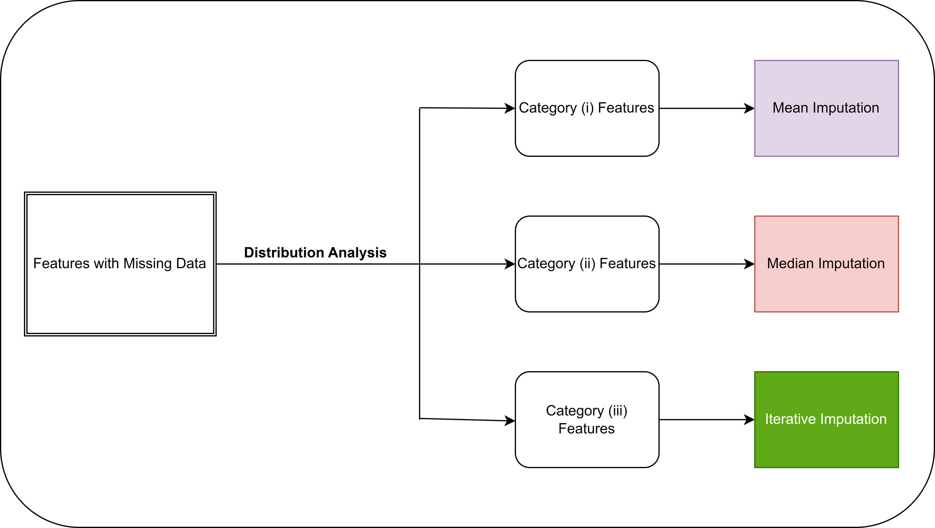
METHODOLOGY
Missing Value Imputation Framework

Slide 10
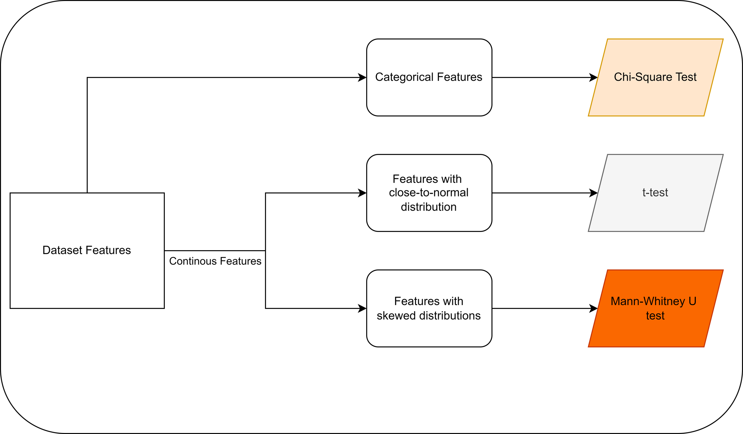
METHODOLOGY
Statistical Analysis

Slide 11
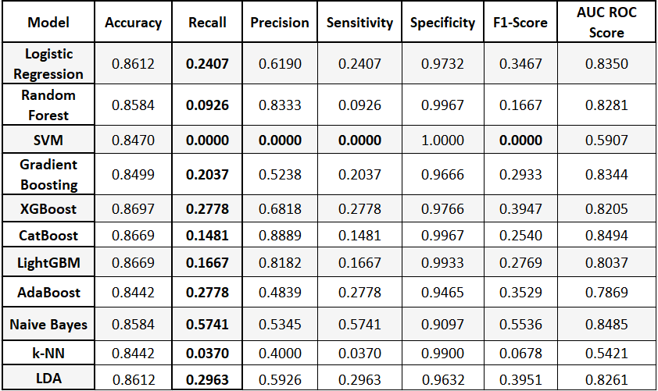
METHODOLOGY
Comparision with the Benchmark Models (Before Scaling and Balancing)

Slide 12
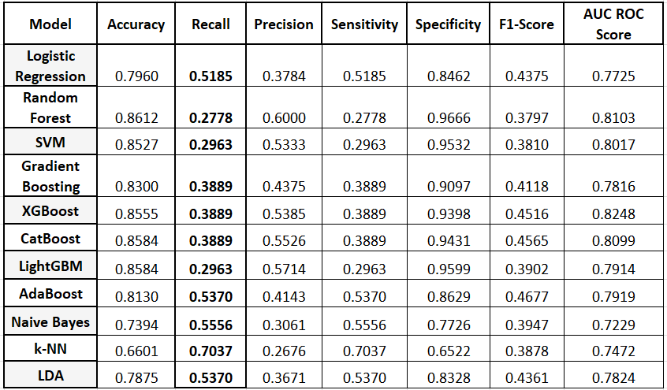
METHODOLOGY
Comparision with the Benchmark Models (After Scaling and Balancing)

Slide 13

Methodology
Voting Classifier and Experimentations
1
2
After extensive experimentation with various ensemble techniques, the voting classifier was finalised for its ability to leverage the strengths of base learners, that improved the predictive performance.
Even within the voting classifier, various combinations of base models with customised weights and custom thresholds were experimented with to develop the final voting ensemble.

Slide 14
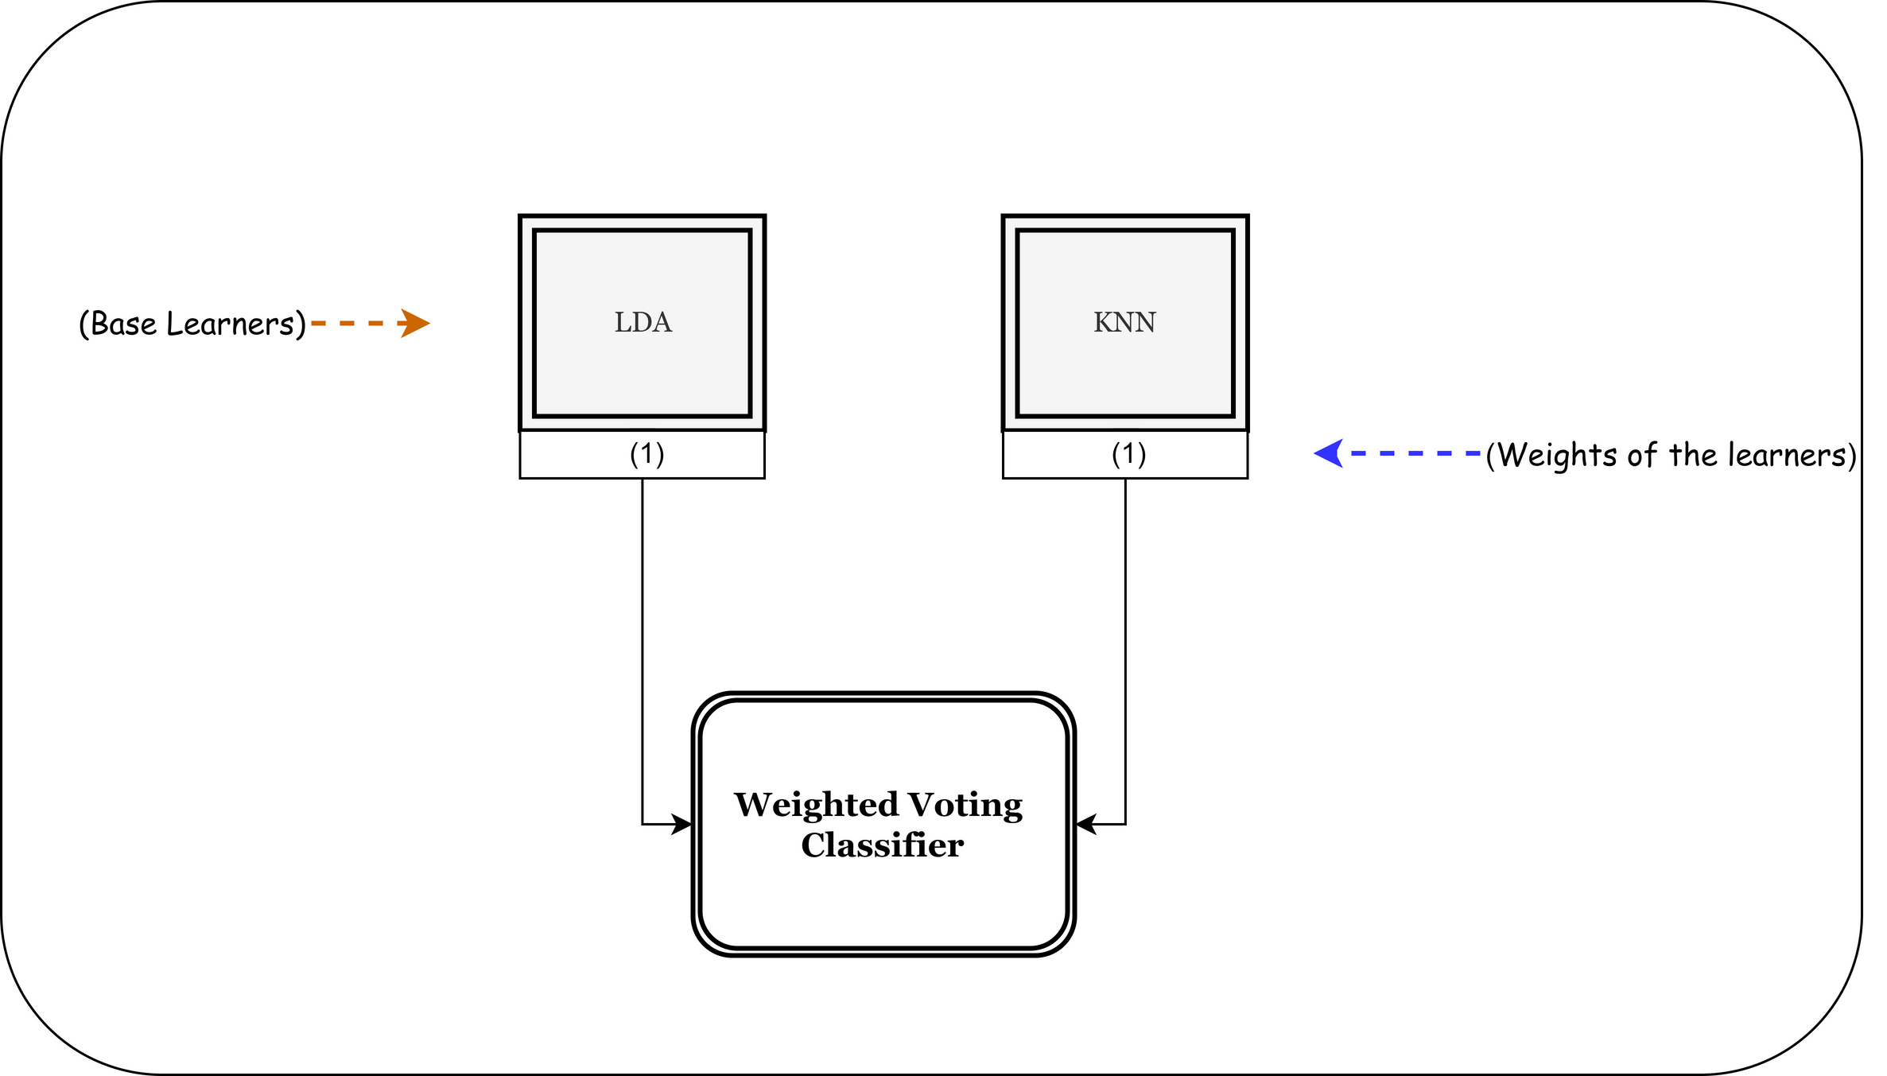
METHODOLOGY
Experimentation: With 2 base learners

Slide 15
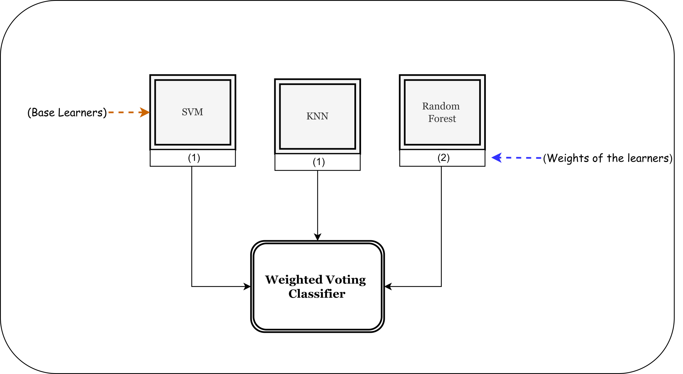
METHODOLOGY
Experimentation: With 3 base learners

Slide 16
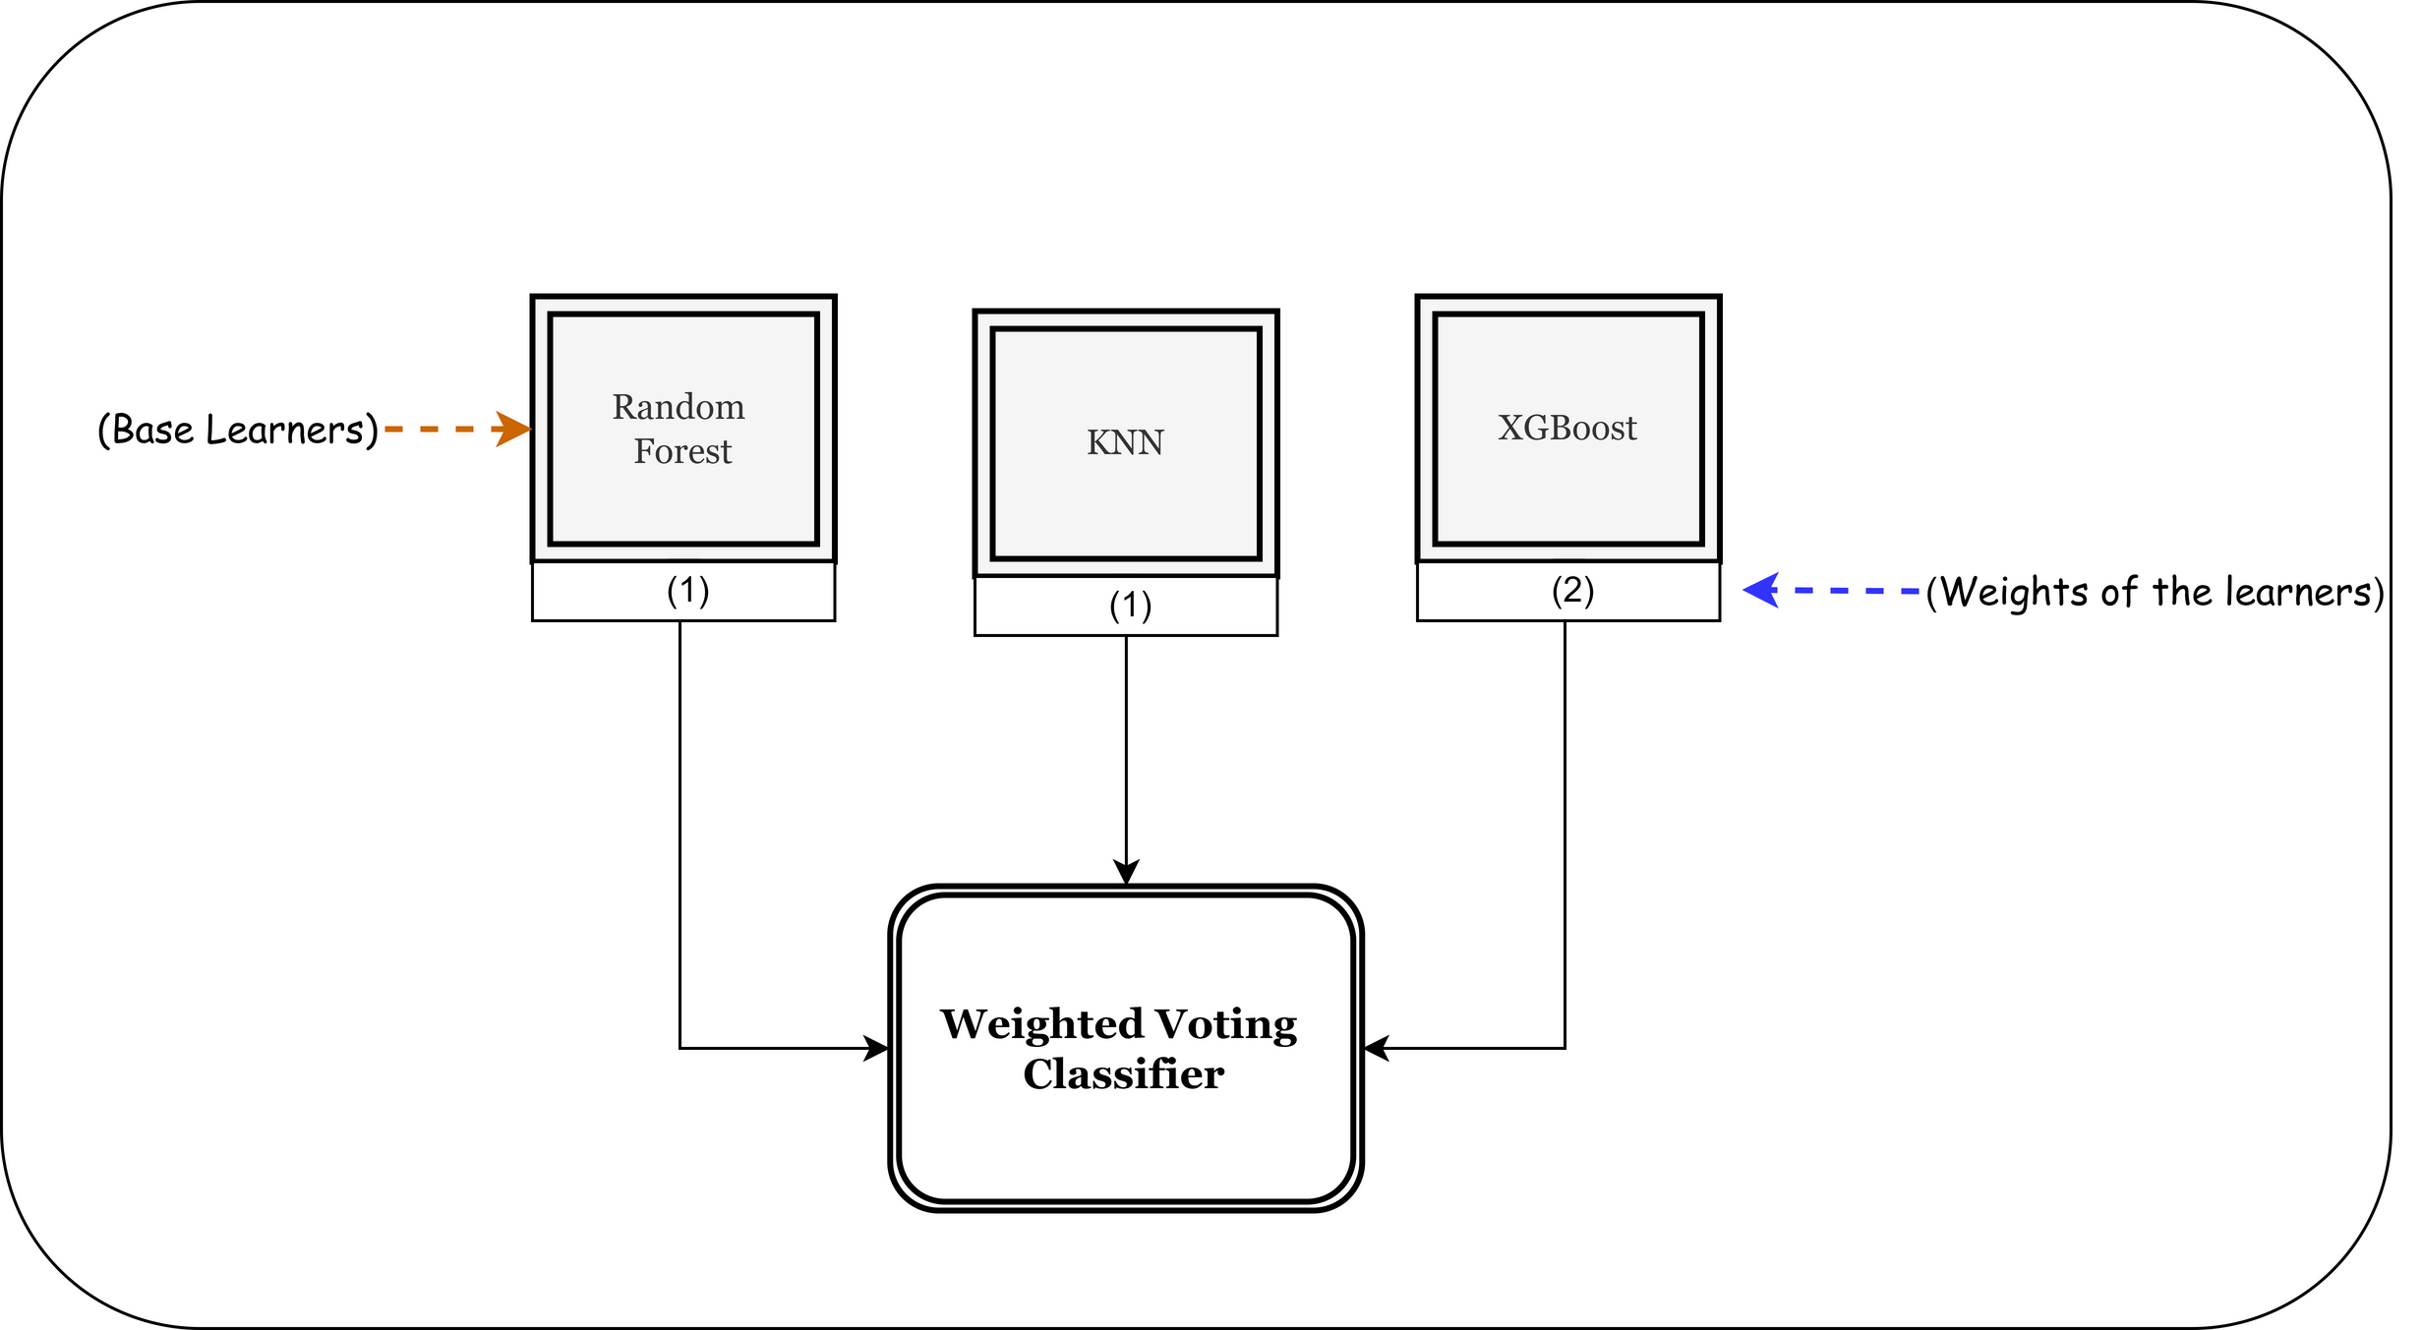
METHODOLOGY
Experimentation: With 3 base learners

Slide 17
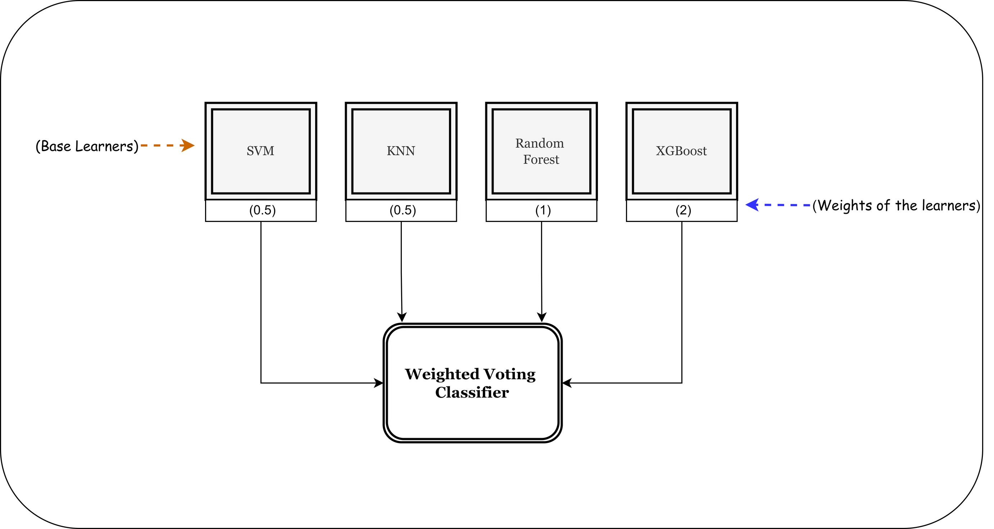
METHODOLOGY
Final Voting Classifier Ensemble Design

Slide 18
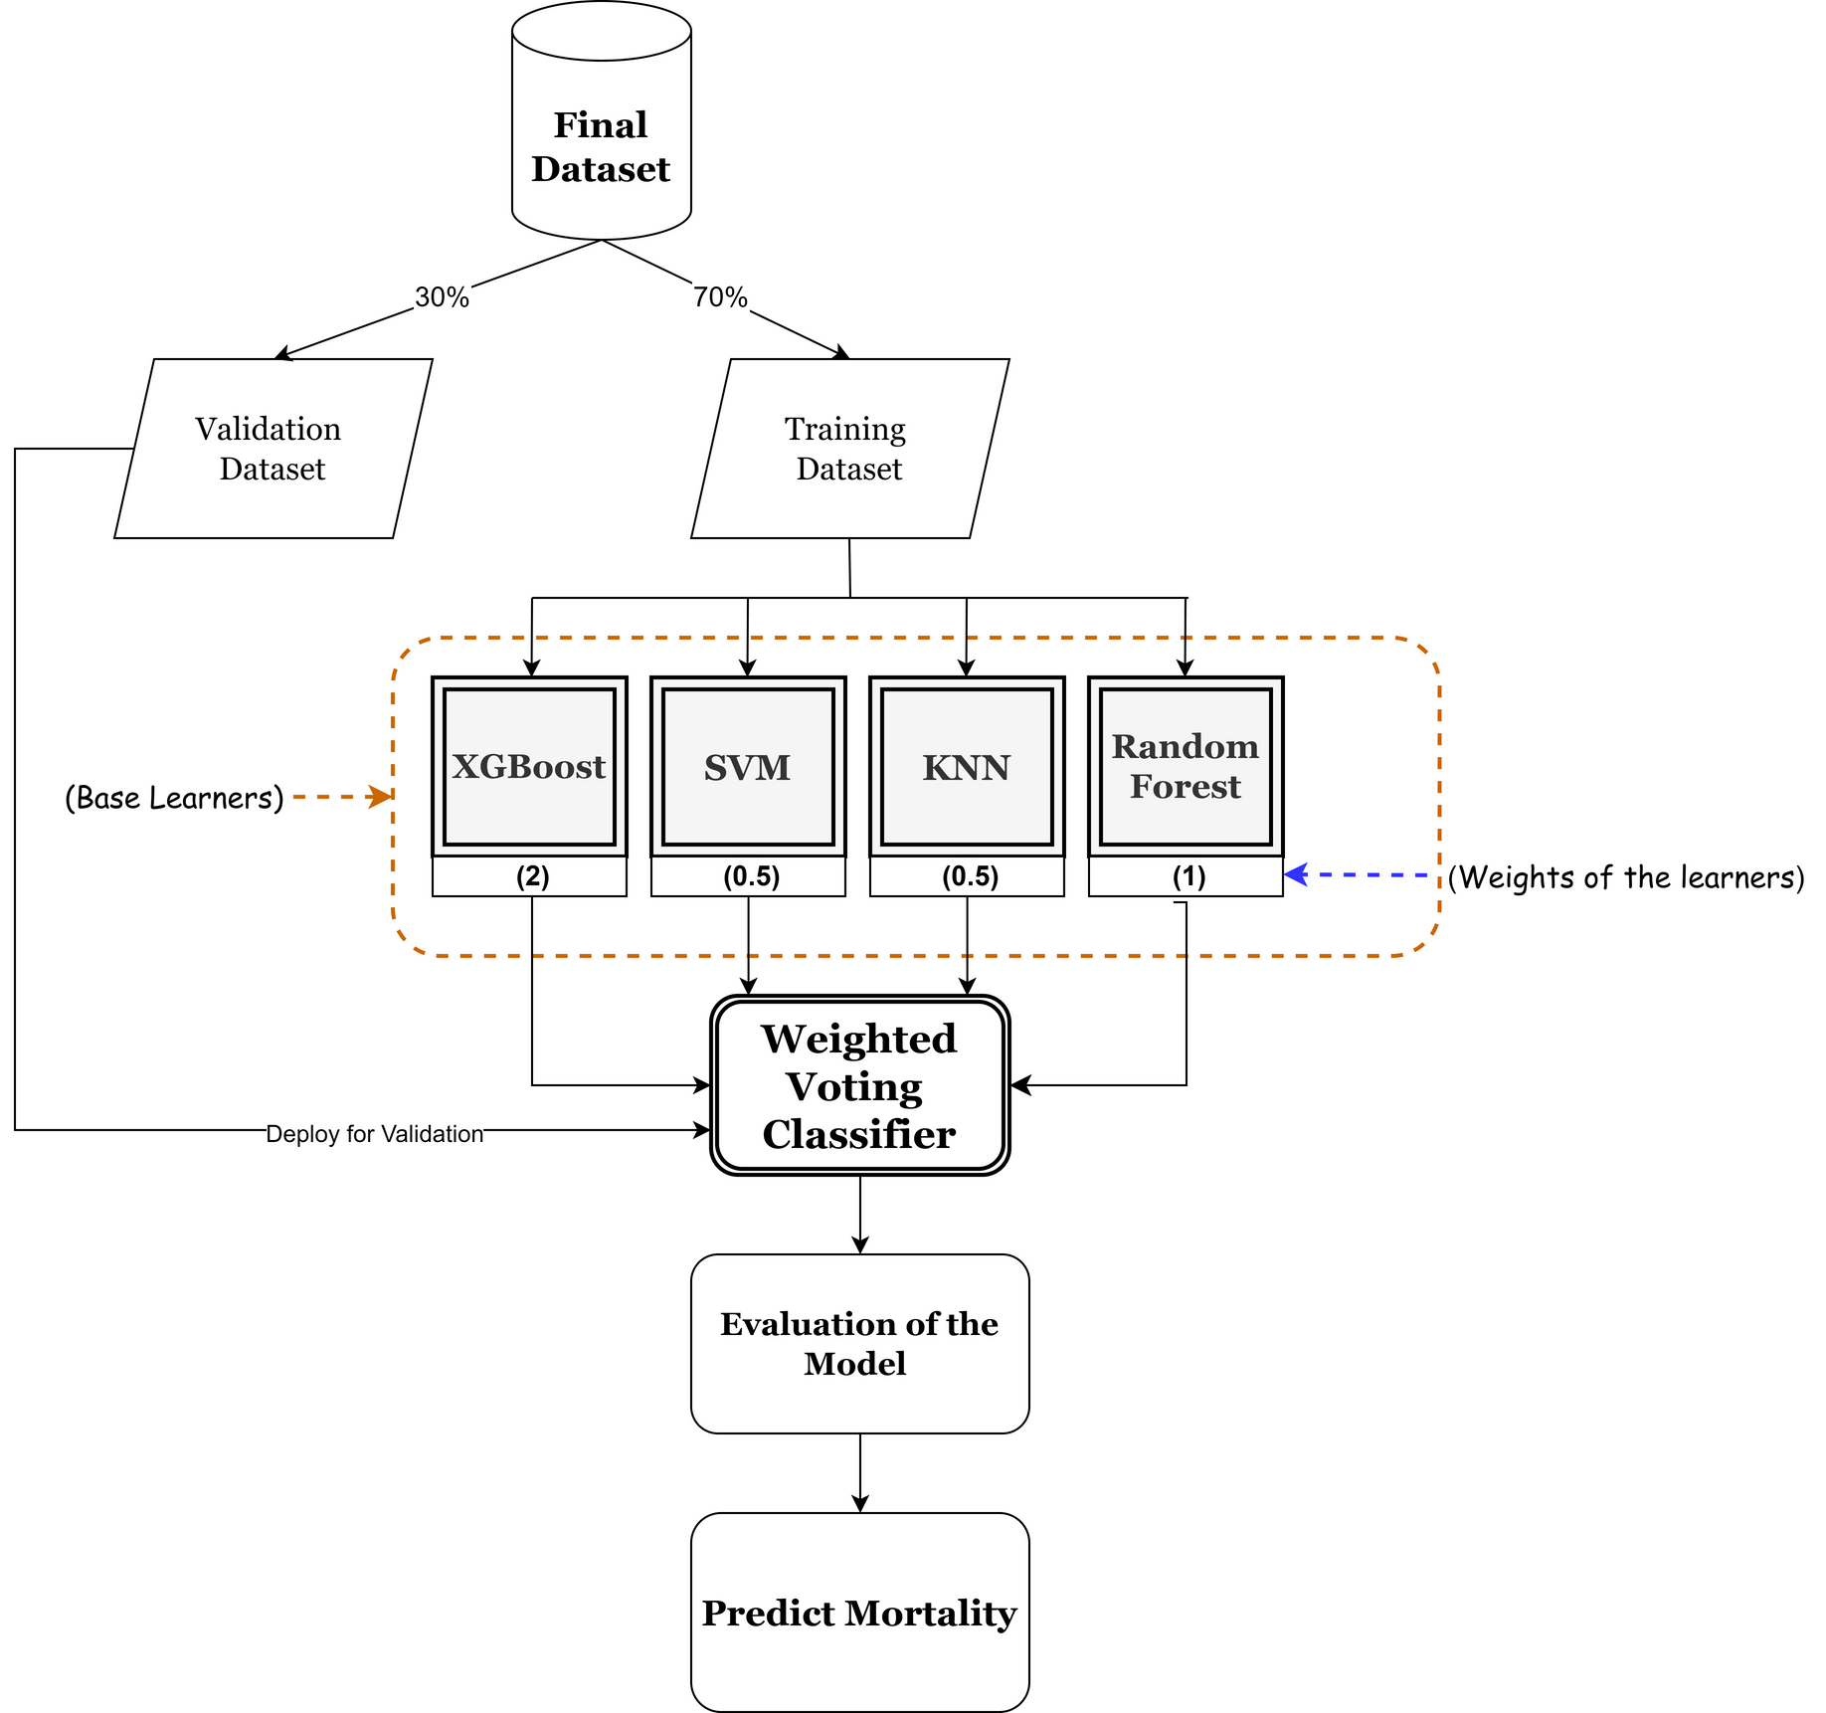
METHODOLOGY
Final Workflow Design

Slide 19
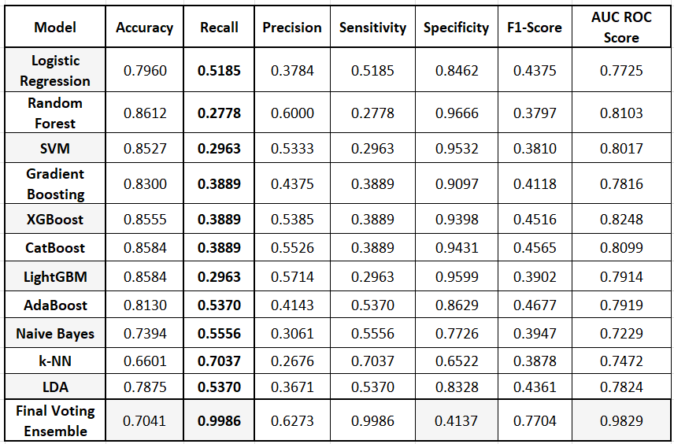
FINAL RESULTS
Comparision of final ensemble classifier with the Benchmark Models

Slide 20
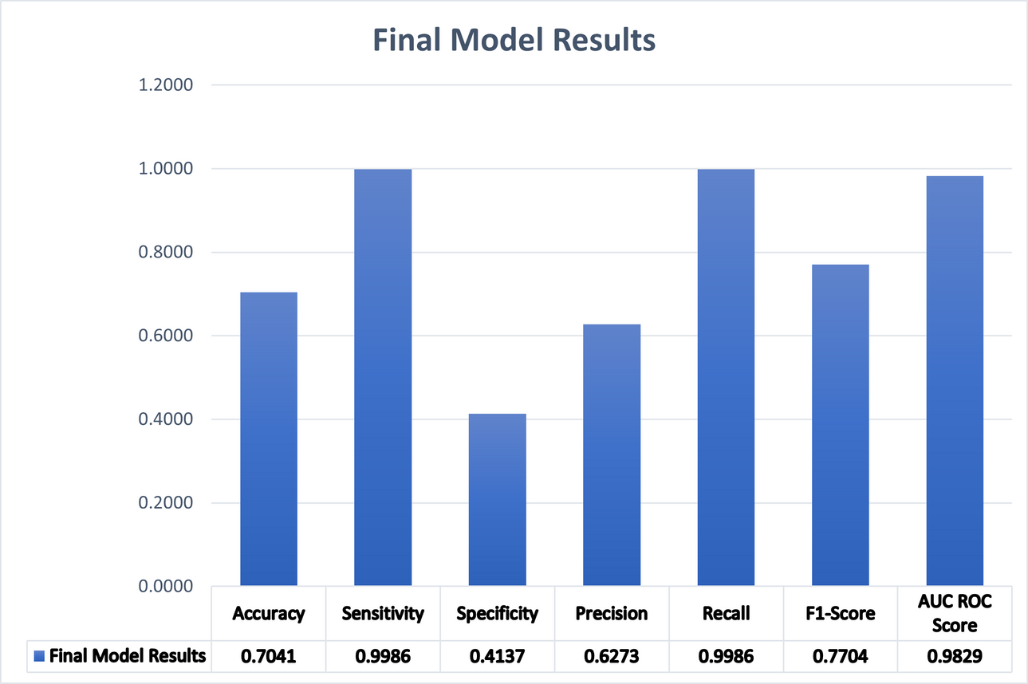
DISSCUSSION
Achieved the highest possible level of recall, showing exceptional capability in detecting true mortality cases.
Showed peak performance in distinguishing between mortality and non-mortality cases, with ROC score.
Reflects robust overall performance with a balanced Sensitivity and Accuracy.
Precision outperforms other benchmark models, though lower than some other experiments; not optimised in this study but still notable.
Specificity is the only metric that is sub optimal due to dataset imbalance; attempts to improve specificity resulted in a trade-off with recall.

Slide 21

CONCLUSIONS
The study enhanced model performance with improved data preparation, scaling, and effective handling of class imbalance, a endemic issue in medical datasets.
The final Voting Classifier Ensemble maximised recall while balancing other metrics optimally, successfully achieving the research goal.
The study provides a practical tool for accurate prediction of high-risk ICU mortality early on using patient physiological data, enabling timely interventions and resource management.

Slide 22

CONTRIBUTION TO KNOWLEDGE
Proves that even a simple voting ensemble can outperform benchmark models, challenging the notion that only advanced methods are effective for this purpose.
Optimises recall without compromising on the other metrics, filling a crucial research gap in mortality studies.
Provides highly accurate predictions using only easily available patient physiological data in an ICU.

Slide 23


FUTURE WORKS
Exploration of more advanced hyperparameter optimisation to further enhance model performance.
Cross-Validation of the Model across diverse ICU settings and patient populations for generalisability.
Collaboration with healthcare institutions and integration of the prediction model with Clinical Decision Support Systems (CDSS) for on-field applications.

Slide 24

Thank
You!

